Slide 1
Predicting MWL from Historic EEG Data using Machine and Deep Learning Methods
Group 3: Mental Workload Prediction
Supervisor: Guillermo Reyes Fuentes
Team Members:
Donald Pfaffmann
Ganavi Basavaraju
Nicolas Tabellion

Slide 2
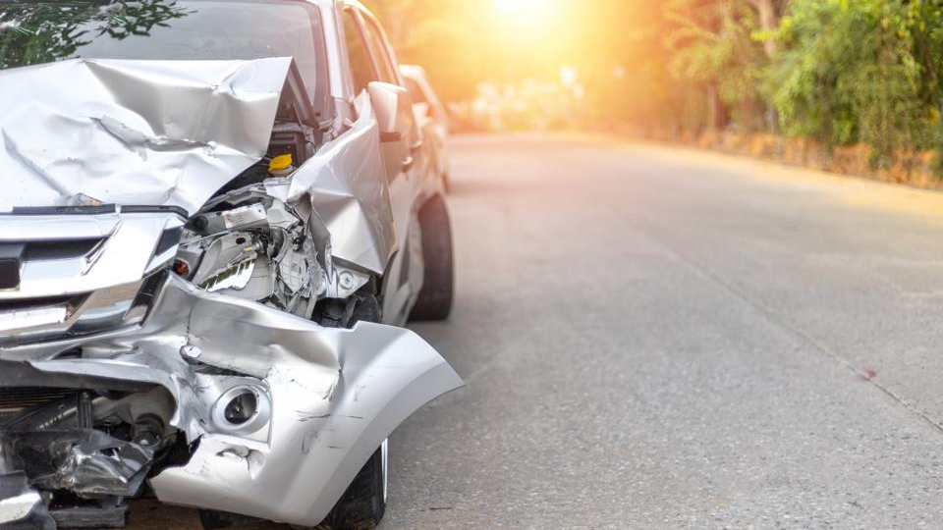
Why Quantify MWL/CWL?
Distracted driving causes about 3,000 deaths per year.
72% of car accidents are caused by human error.
Measuring MWL and transferring control to vehicles could avoid accidents caused by distracted driving.

Slide 3

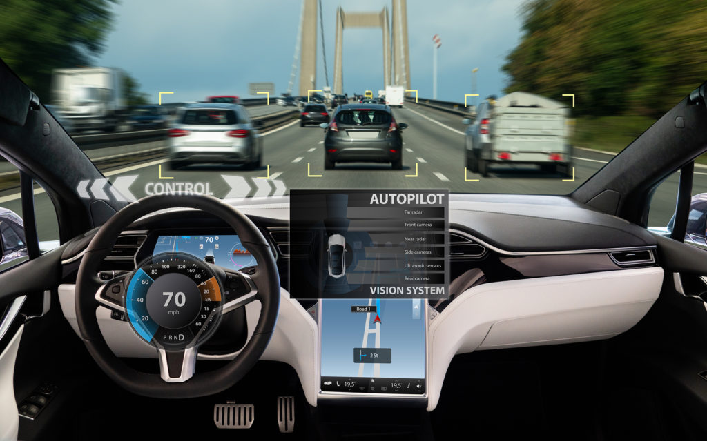
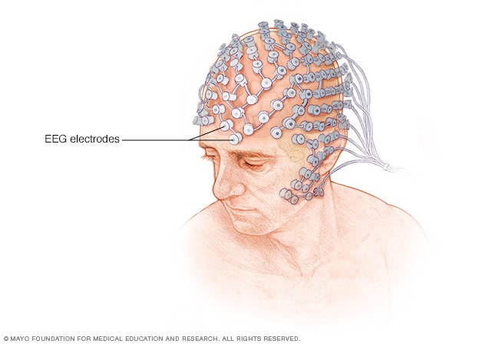
Idea
Cognitive Workload ?
High ?
Low ?
Measure MWL/CWL using EEG
Classification
Transfer control between Driver and Vehicle

Slide 4

Overview
Data Acquisition: How-To
Data Evaluation: Questions & Challenges
Data Evaluation: Satus-Quo
Classification Results
Interface Design

Slide 5
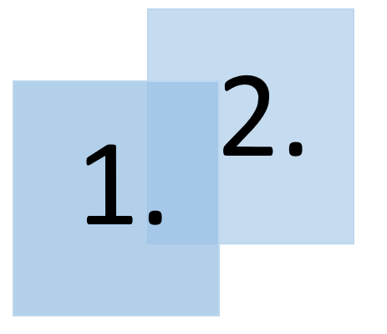
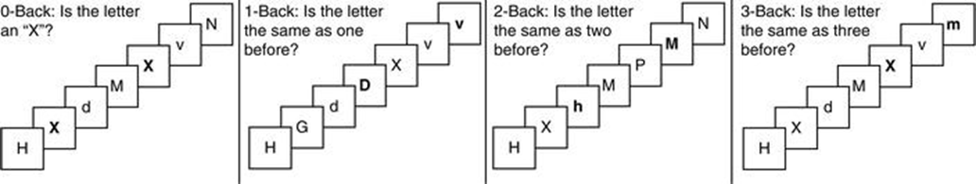
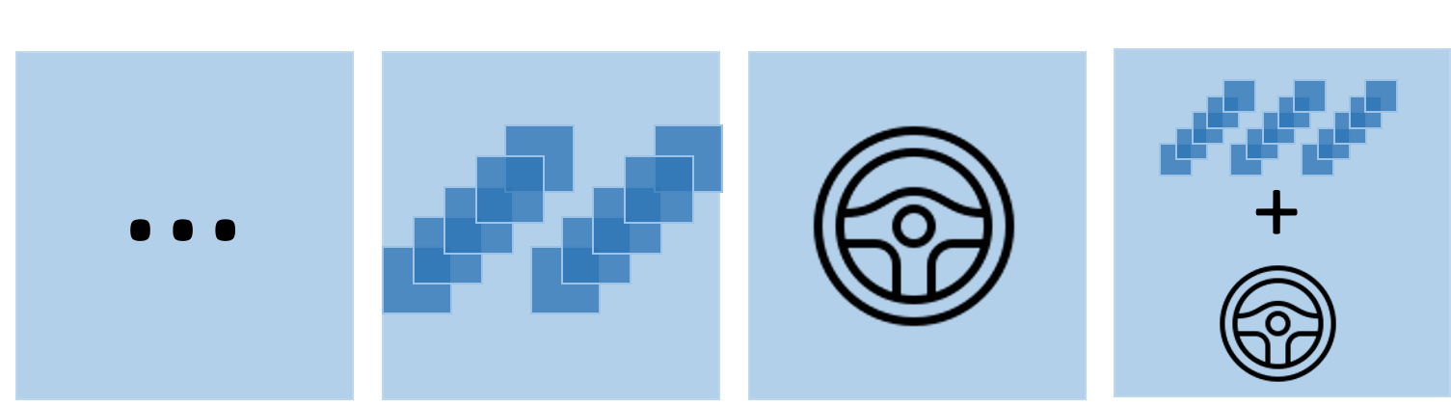
Data Acquisition: How-To
Primary/Secondary task paradigm
Auditive 2-back as secondary task
n-back task
driving
4 different recording scenarios:
idle n-back driving driving & n-back

Slide 6
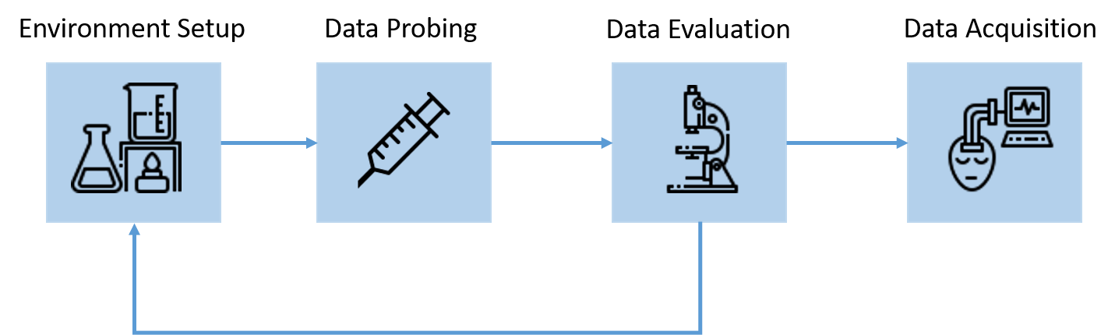
Data Acquisition: Status Quo
3 recording session of 1 hour each
4 scenarios of 15 minutes each
3 subjects of 5 minutes each

Slide 7
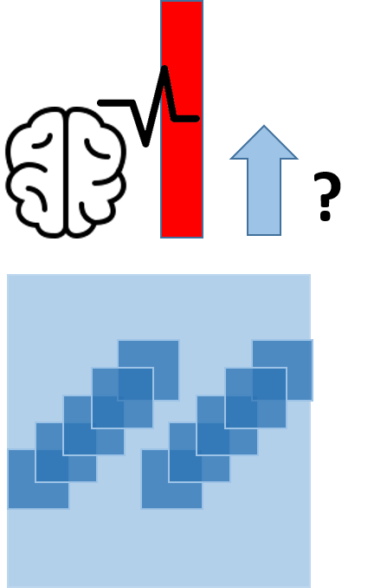

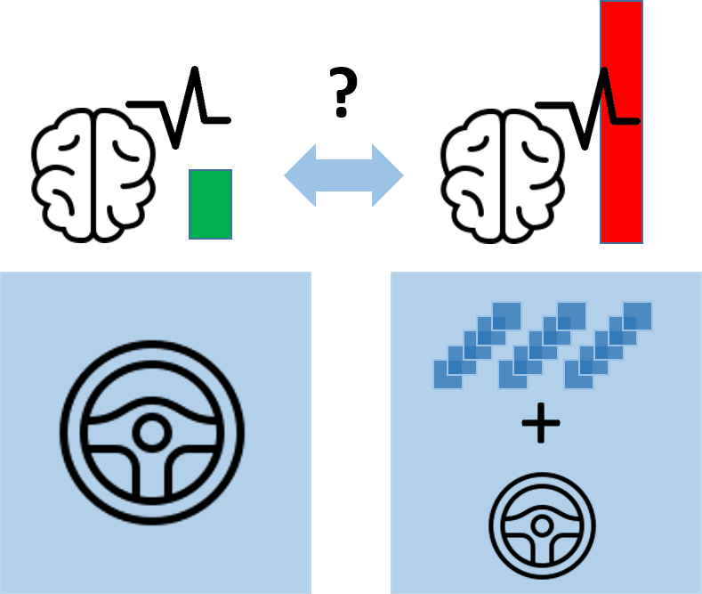

Data Evaluation: Questions & Challenges
Do EEG signals under secondary task correspond to high mental workload?
data quality
signal-to-noise ratio
conceptual feasibility?
proper data recording?
Inter-session & inter-subject generalizability?

Slide 8

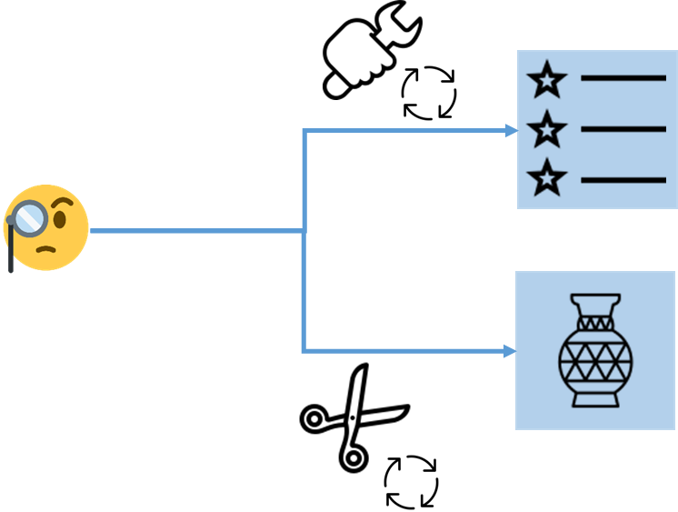



Data Evaluation: How-To
What we use to implement everything:
What we had to do:

Slide 9
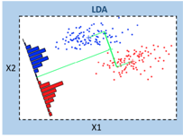
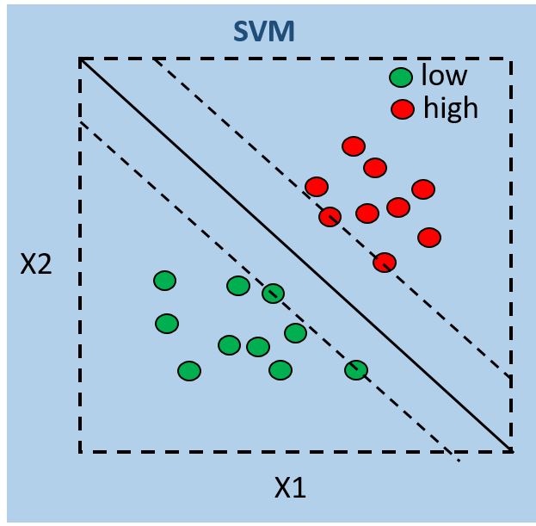


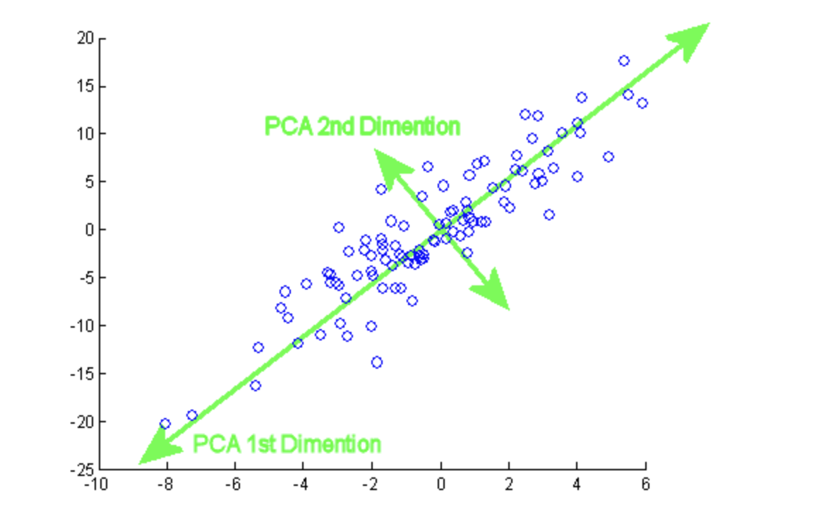
Data Evaluation: How-To
pre-processed
EEG
signals
calculate features manually
reduce dimensionality
quantify separation
delta (0-4Hz),
theta (4-8Hz),
alpha (8-13Hz),
beta (12-31Hz),
gamma (31-50Hz) ,
(alpha + theta)/beta, alpha/beta, (alpha+theta)/(alpha+beta), theta/beta.
PCA

Slide 10
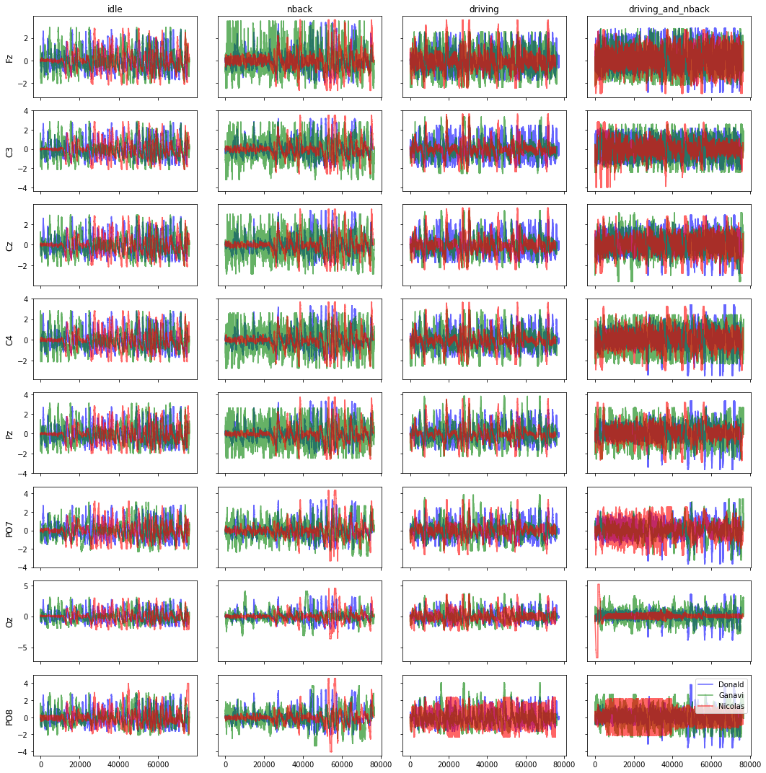

Slide 11
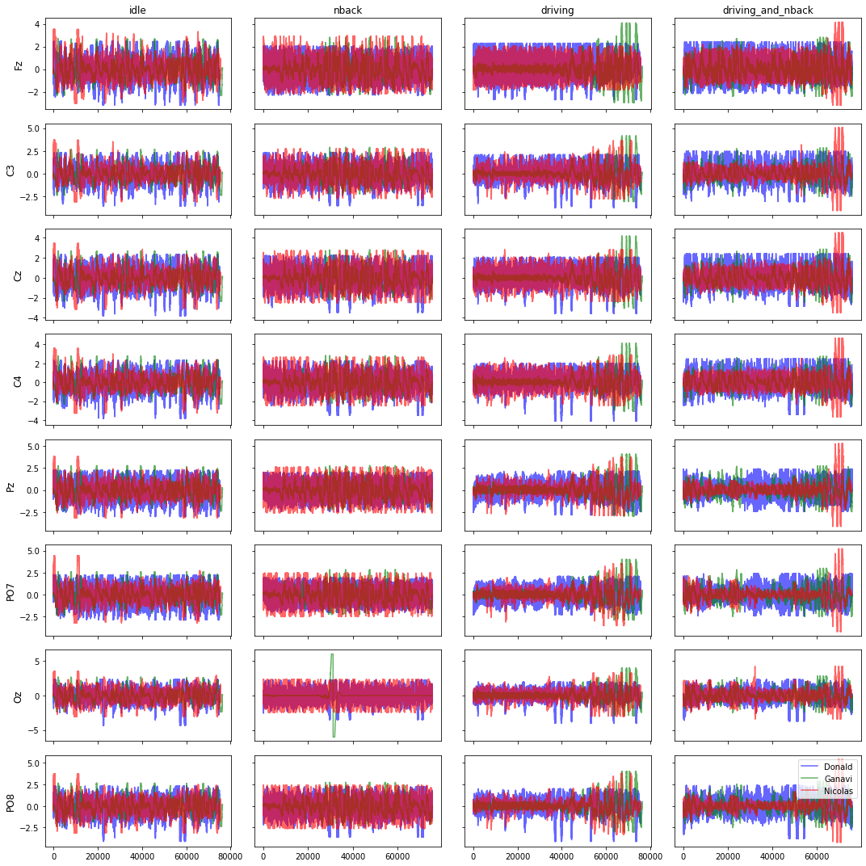

Slide 12
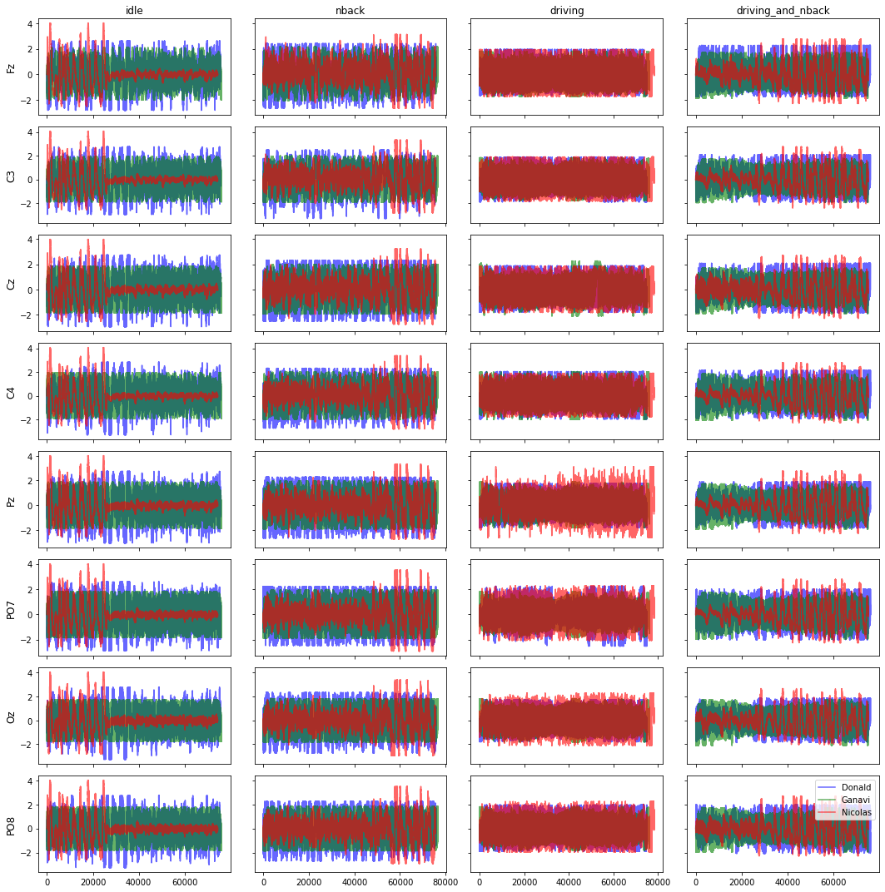

Slide 13
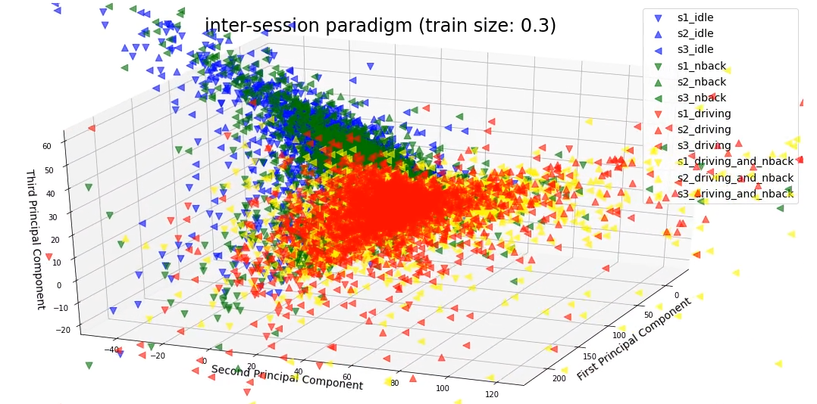
Data Evaluation: PCA (inter-session)

Slide 14
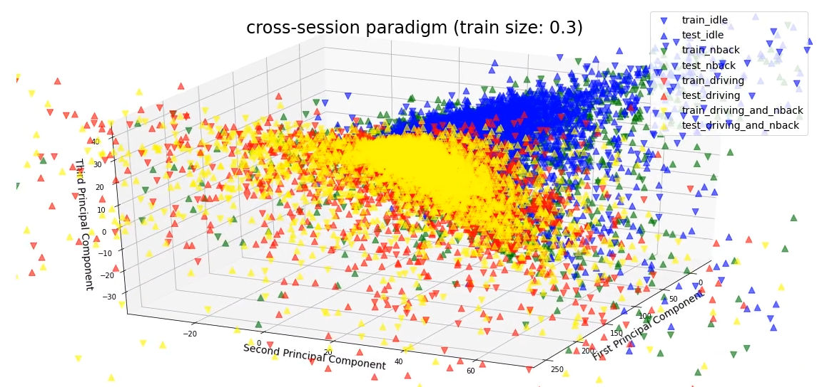
Data Evaluation: PCA (cross-session)

Slide 15
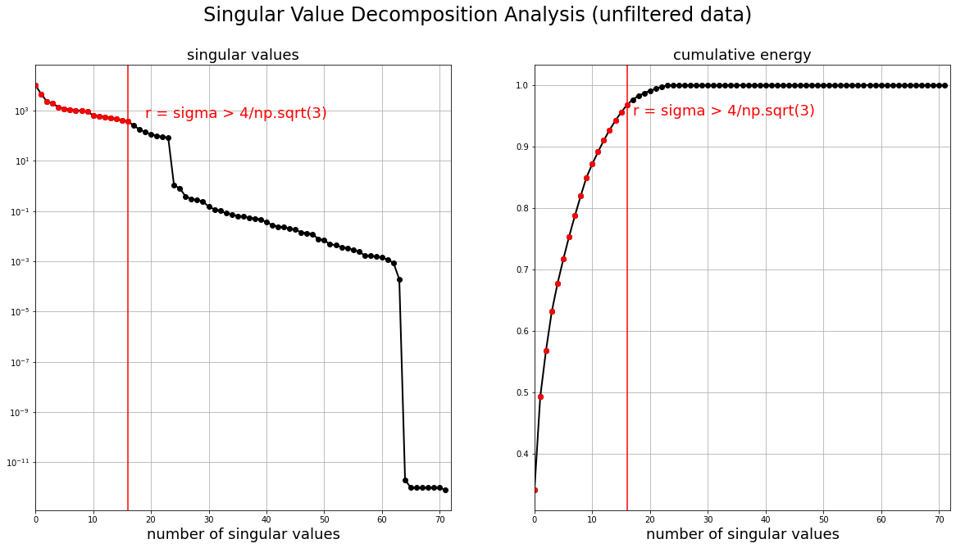
Data Evaluation: SVD

Slide 16
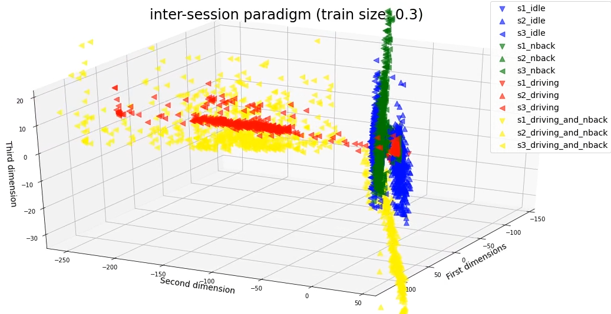
Data Evaluation: LDA (inter-session)

Slide 17
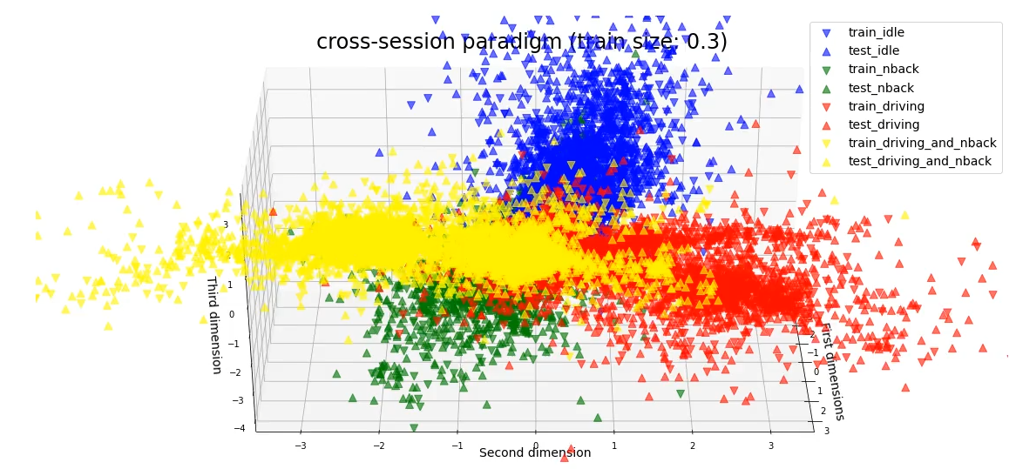
Data Evaluation: LDA (cross-session)

Slide 18
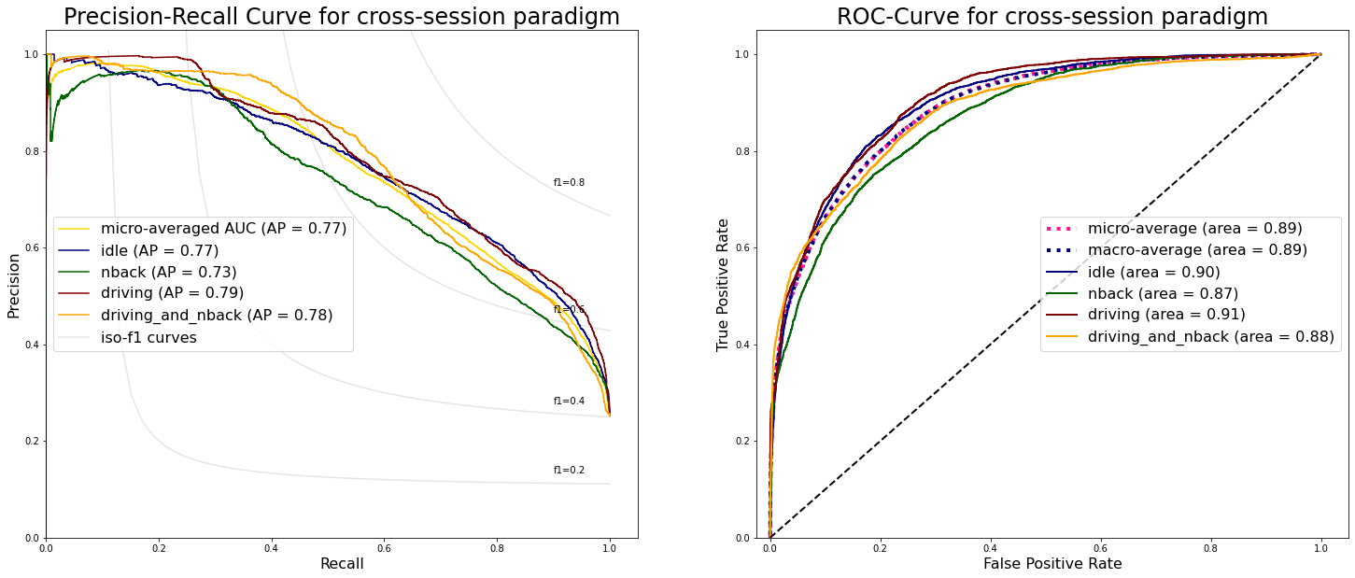
Data Evaluation: Performance of LSVCs

Slide 19
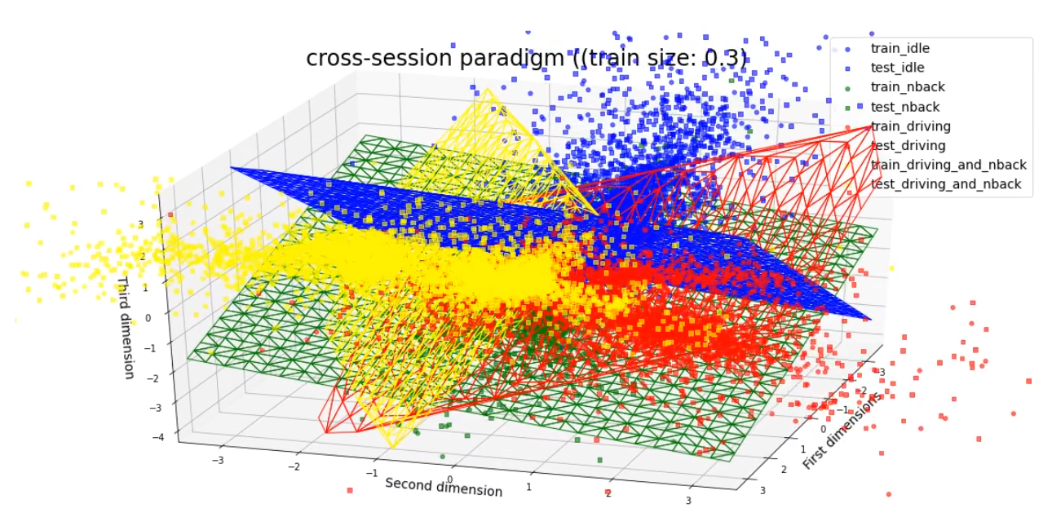
Data Evaluation: Decision Surfaces

Slide 20


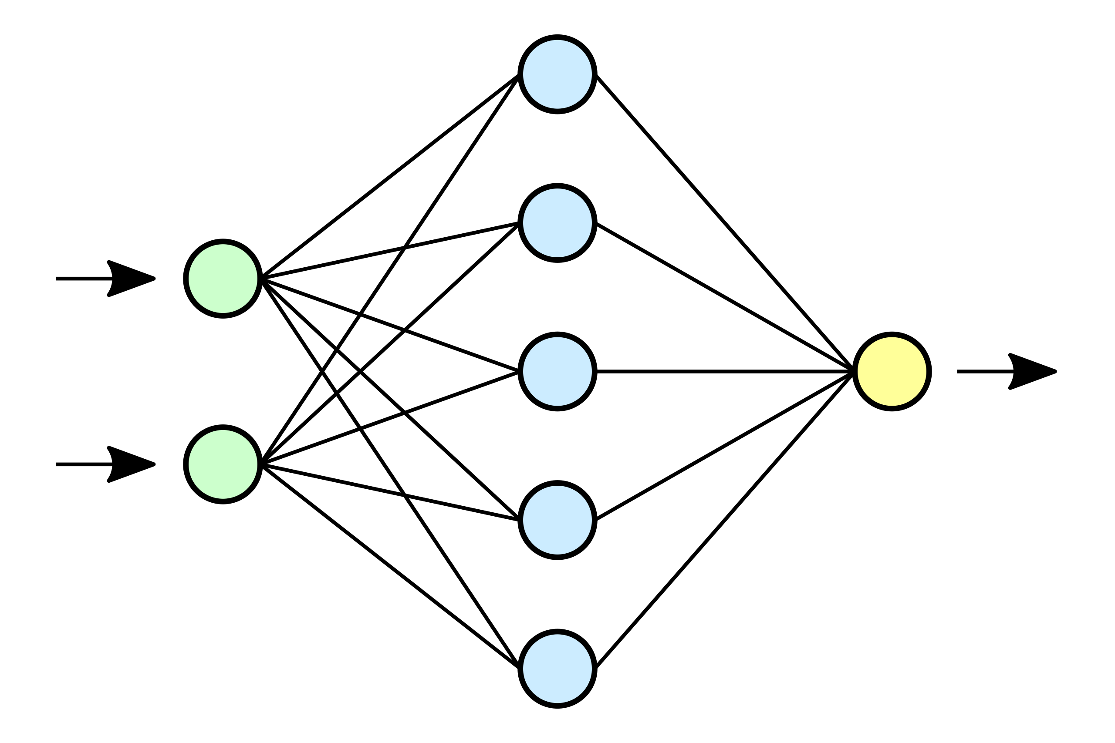
Model Implementation: Open Questions
Notes:
Which metric do we use to measure model performance?
What would be an acceptable performance threshold?
How high should the CNN-AE‘s performance be for us to accept the resulting feature set as adequately representing the original signal?
How high should the RF‘s performance be for us to believe it can adequately judge the importance of that a given feature?

Slide 21
Classification Results
Random Forest and k-Nearest Neighbor

Slide 22
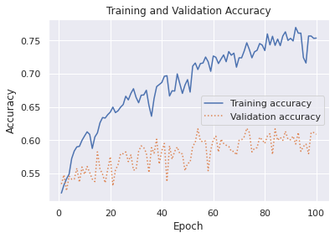
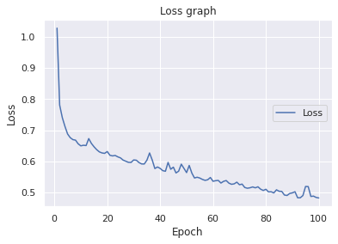
Neural Networks – Classification (Cross-Session)
1- Hidden layer perceptron, the achieved test accuracy was 76.34%.

Slide 23
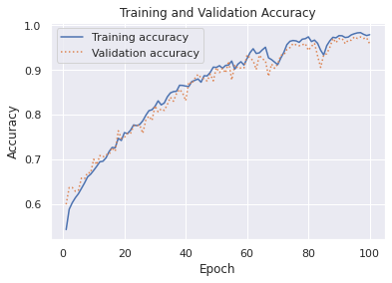
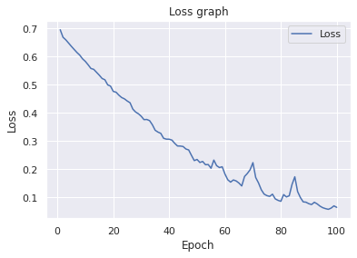
Neural Networks – Classification (Cross-Session)
5 layer- MLP, The achieved test accuracy is 89.74%.

Slide 24


Neural Networks – Classification (Inter-Session)
Model trained on data from Session 1 and tested on Session 2.
The achieved test accuracy is 73.4%.

Slide 25
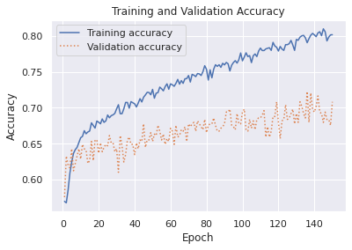
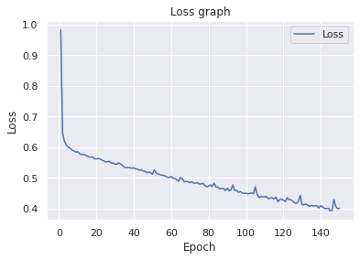
Another Approach: Intra-Subject & Cross-Session
Training the model on individual’s data from all 3 session.
The test accuracy is 70.82%

Slide 26


Interface

Slide 27
Interface | Requirements
Goal:
When high CL is reached
give suggestion to driver to activate autopilot
enable driver to perform the activation

Slide 28
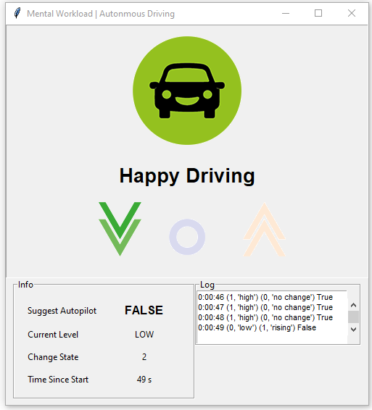
Interface | Overview
Consists of three views:
Visual view
Update graphics when states change
Info view and Log View
Display summary of relevant value

Slide 29
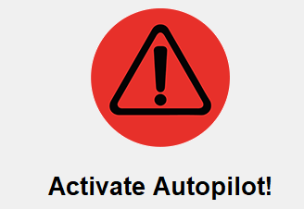
Interface | State
Reading from the binary results of the model prediction
Two States:
High MWL
Suggest to turn on autopilot
Low MWL
Everything is fine

Slide 30
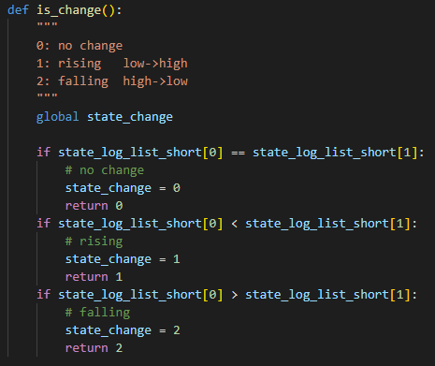



Interface | State Change
Falling
Rising
Compare previous and current state
No Change
State change value

Slide 31
Interface | Suggest Autopilot
Suggest the use of autopilot
Audio Signal
Play repeating beep sound when in a high state of MWL
Play longer beep sound when level is falling again

Slide 32
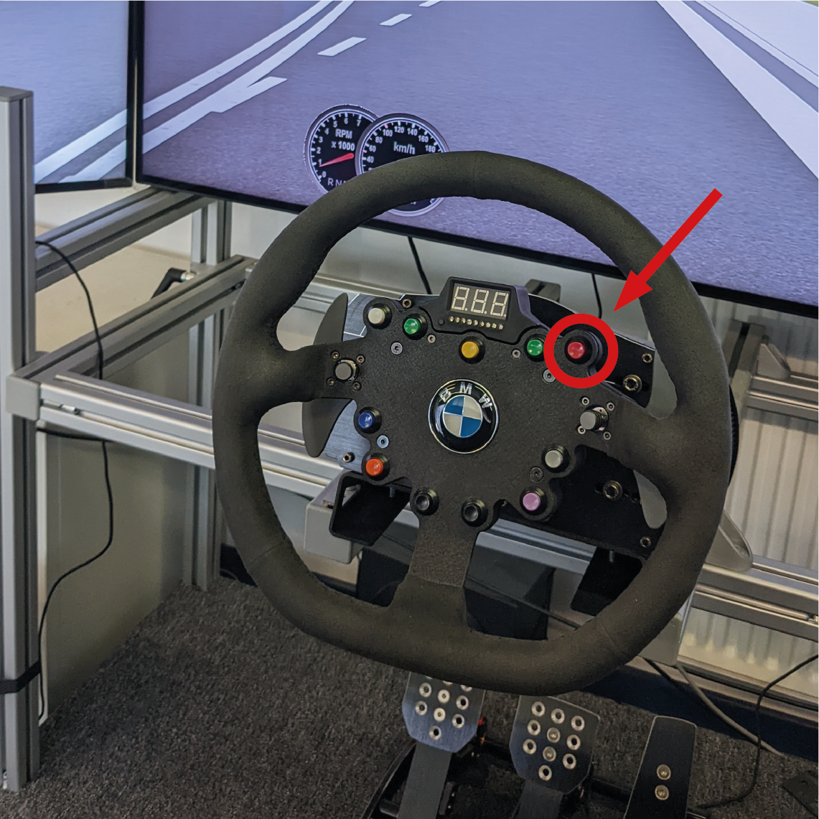

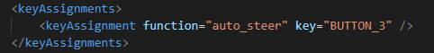
Interface | Activate Autopilot
Enable driver to comfortably activate autopilot
Utilize steering wheel
Edit OpenDS task settings
Assign "auto-steer" function to button on steering wheel

Slide 33
Interface | Conclusion/Outlook
Can be extended further
Utilizing opends built-in settingscontroller component
Subscribe/publish via xml commands

Slide 34

Demo - Video

Slide 35
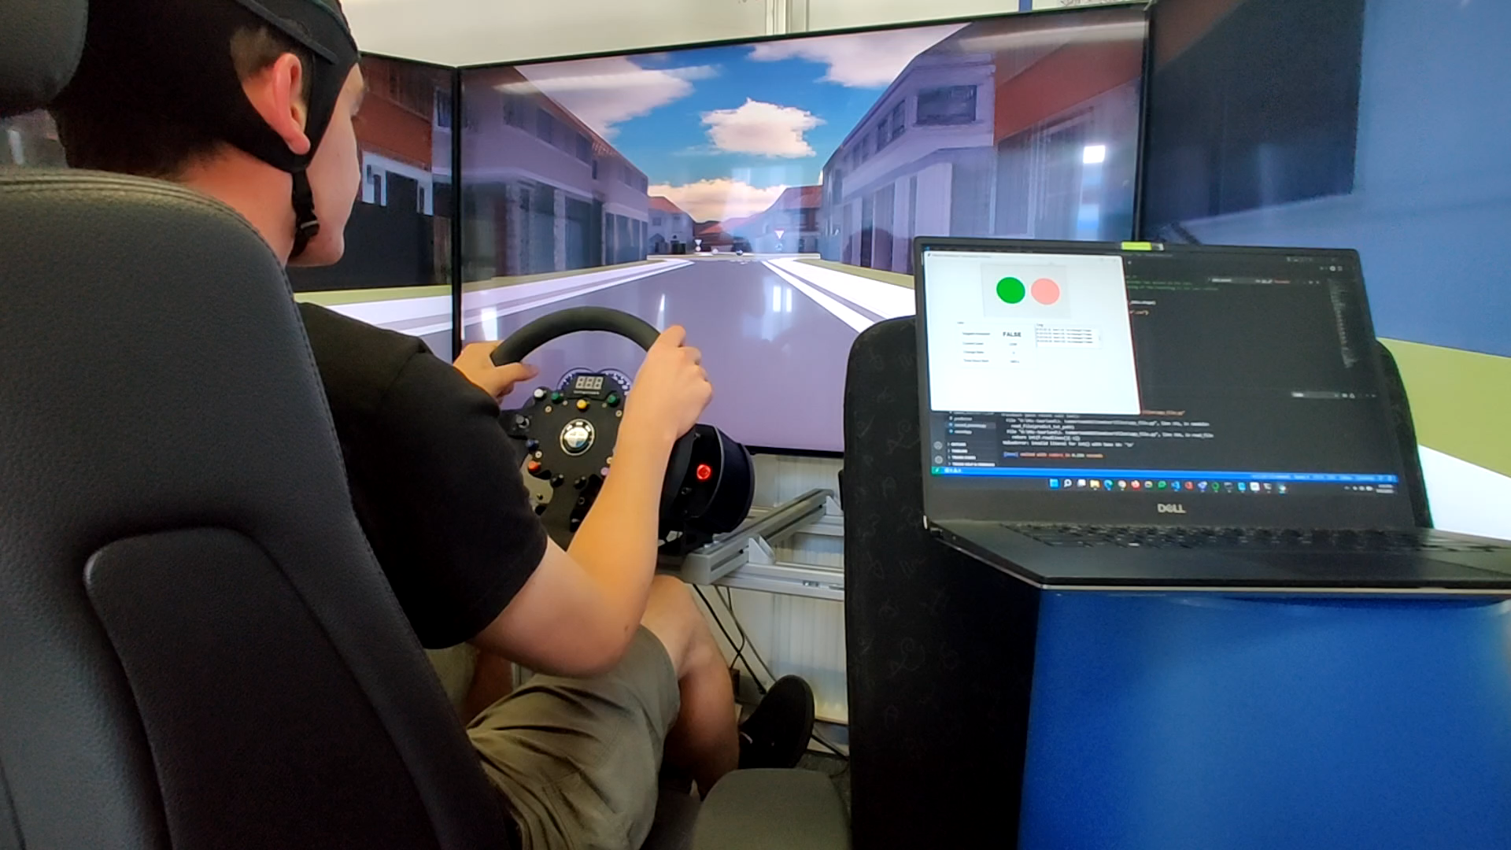

Slide 36
Results & Future Work
Inter-session paradigm appears to be very difficult
We cannot reliably predict live EEG data from historic data
Cross-session paradigm has satisfactory performance
The adequacy of the experimental setting has been confirmed
The quality of the data (signal-to-noise ratio) appears to be decent
Intra-subject paradigm perform suprisingly worse than cross-subject
Most likely because of less data
Can we replace traditional feature extraction approach with a CNN-AE?

Slide 37

Thank you for your attention
Questions?
Notes:
This concludes my ppt. Thank you and if you have any questions please go ahead.

